Slide 1
Light ray
Jamie has bought a new torch.
On the packet there is a picture.
It shows how the torch makes a powerful beam.

Slide 2
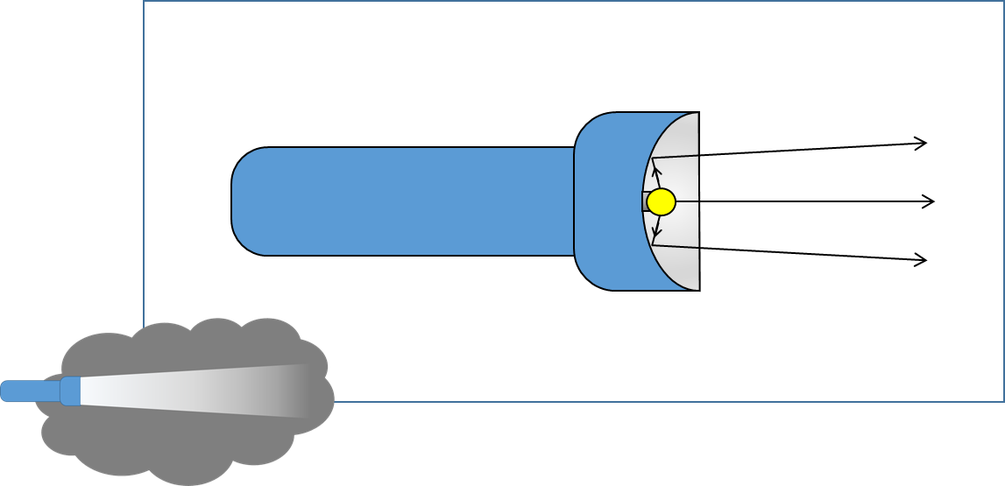
Light ray
What do you know about the light rays shown in the picture?
I am sure this is right
I think this is right
I think this is wrong
I am sure this is wrong
A
A light ray is a long thin piece of light
B
Light is made of light rays added together
C
Light rays show the direction light moves

